Slide 1


Slide 2
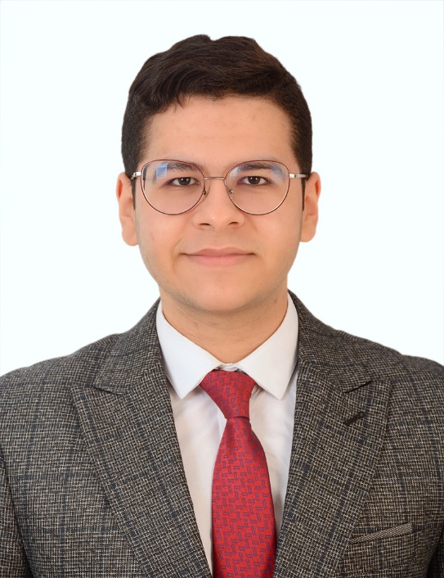


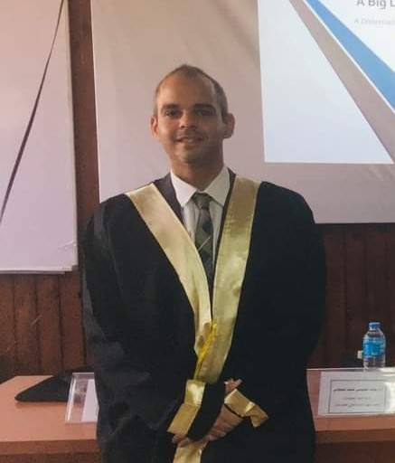

Team Members
Ahmed Einshouka
Abdelrahman Darwish
Ibrahim Zaki
Dr.Youssef Senousy
Team leader
Member
Member
Supervisor

Slide 3
Table of content
Introduction
Literature Survey
system Analysis
system design
Implementation
Conclusion and Future Work

Slide 4

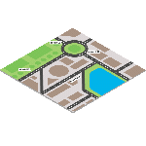

Overview
Purpose: Guide Go assists low-budget travelers by offering various travel-related services such as tour guides and destination exploration.
Objective: The aim is to enhance travel experiences for these travelers
by providing reliable and affordable options.
The project is divided into key features:
Tour Guides: Connect users with local experts for valuable insights.
Destinations: Help travelers explore various destinations effectively.
Weather Information: Provide up-to-date weather information for better planning.
Chat Bot Assistance: Offer a chatbot to answer queries and provide assistance.
Ratings and Feedbacks on Restaurants: Provide ratings and feedbacks to help travelers choose the best dining options.
Goal: Overall, Guide Go strives to make travel easier and more enjoyable for low-budget travelers.

Slide 5
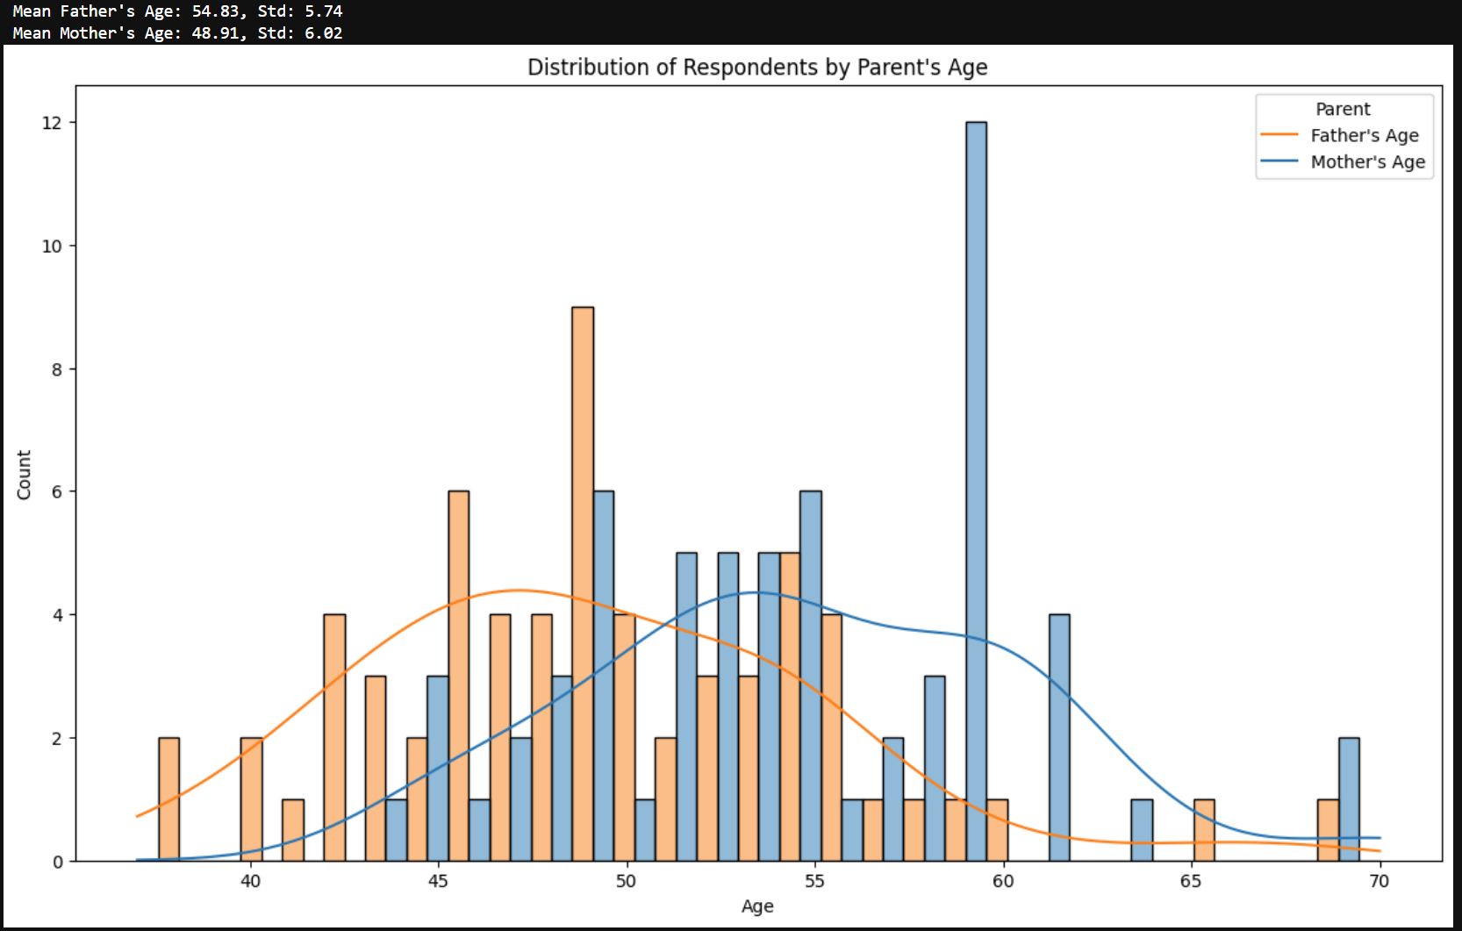
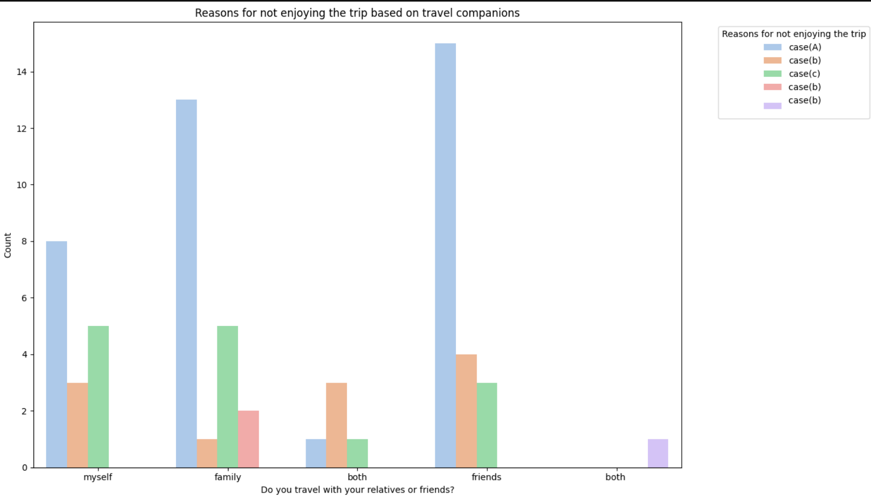
Problem Statement
What steps should I take if I don’t know anyone with similar interests or of the same age, and I’m unfamiliar with the destination I plan to travel to??
Figure(1)
Figure(2)

Slide 6
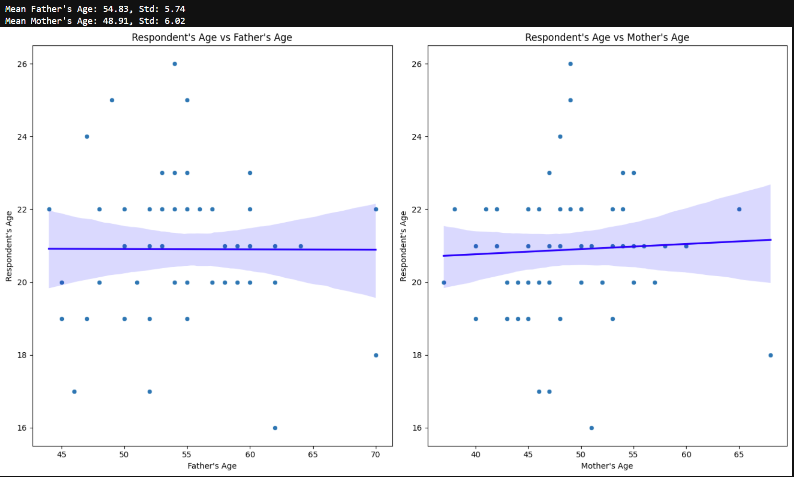
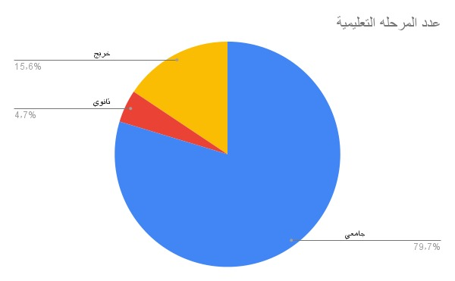
Figure(3)
Figure(4)
Data notebook resource : https://github.com/ahmedeinshouka/gude_go_analysis

Slide 7
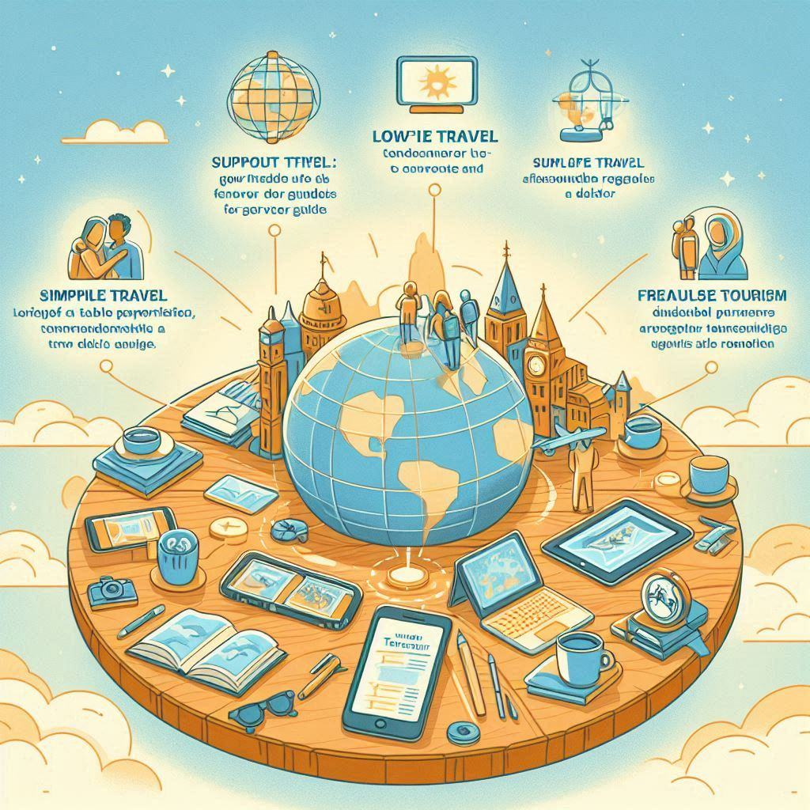
Project Objectives
Support Low-Budget Travelers: Provide an all-in-one platform featuring tour guides to enhance the travel experience.
Simplify Travel: Ensure travel is enjoyable and accessible for everyone, regardless of their budget.
Foster a Travel Community: Connect travelers with service providers to share knowledge, promote responsible tourism, and support freelance tour guides.

Slide 8
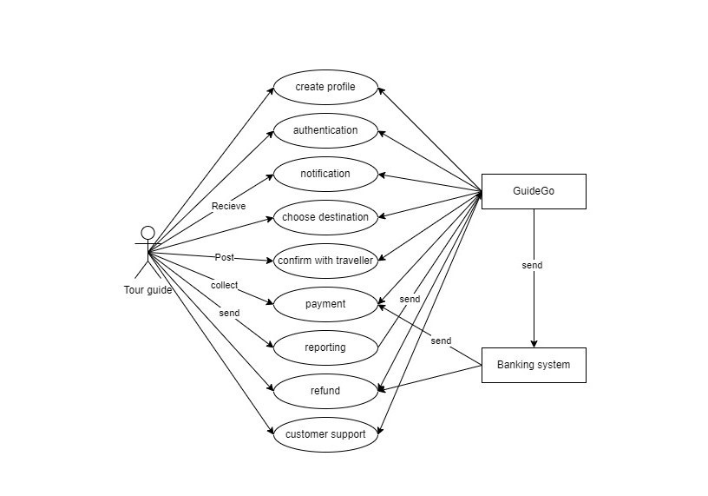
Use Case Diagram

Slide 9
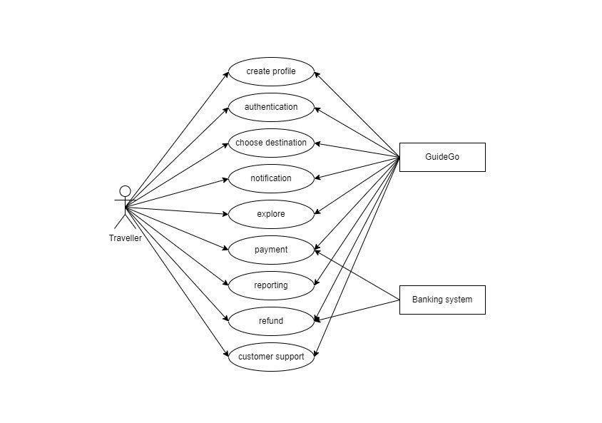
Use Case Diagram

Slide 10
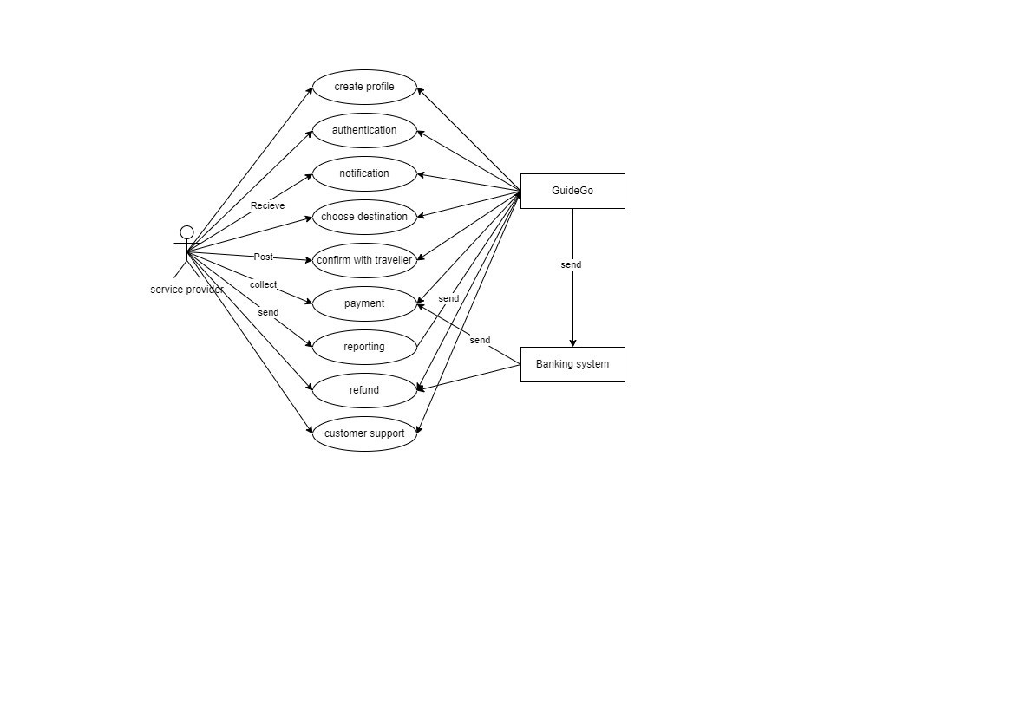
Use Case Diagram

Slide 11
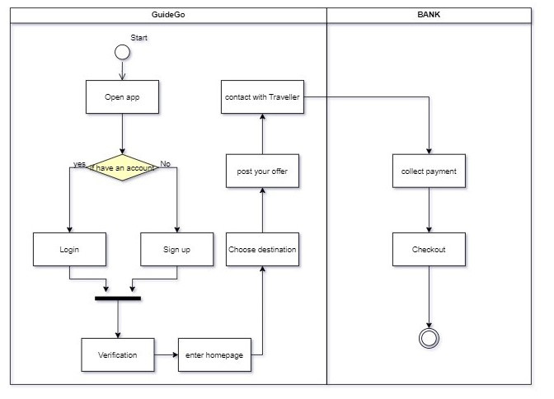
Activity Diagram

Slide 12
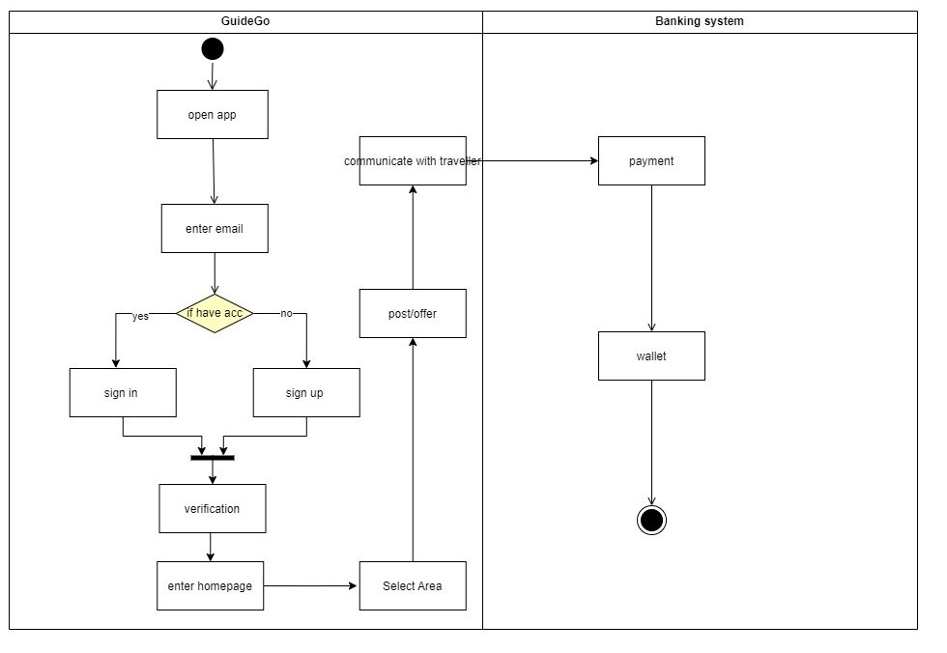
Activity Diagram

Slide 13
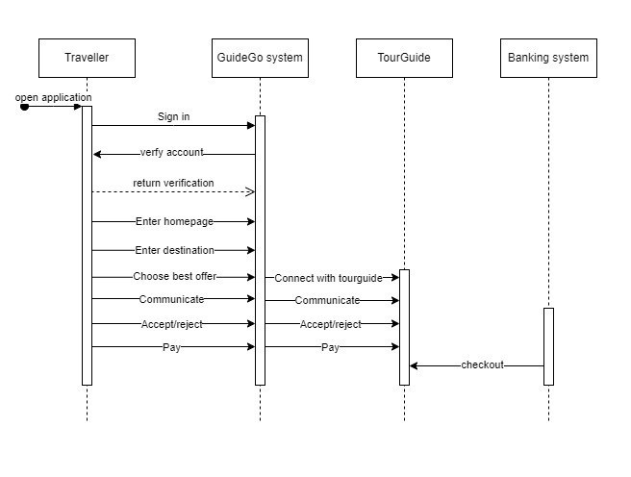
Sequence Diagram

Slide 14
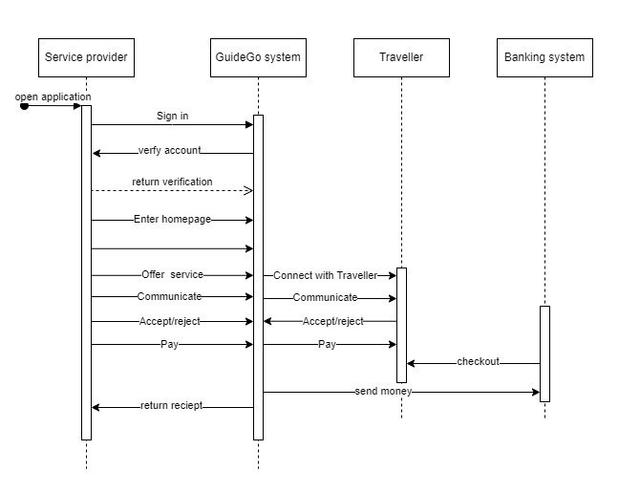
Sequence Diagram

Slide 15
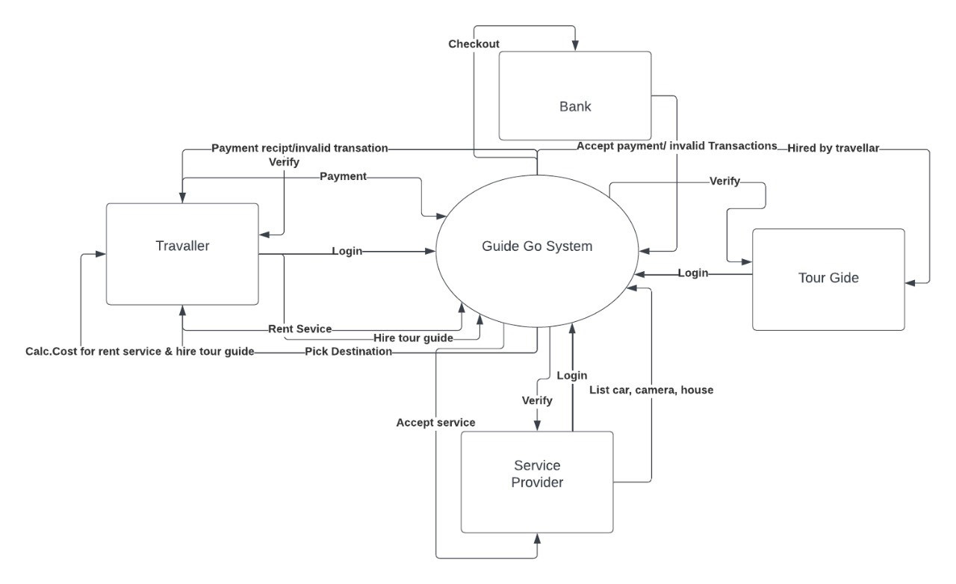
Context Diagram

Slide 16
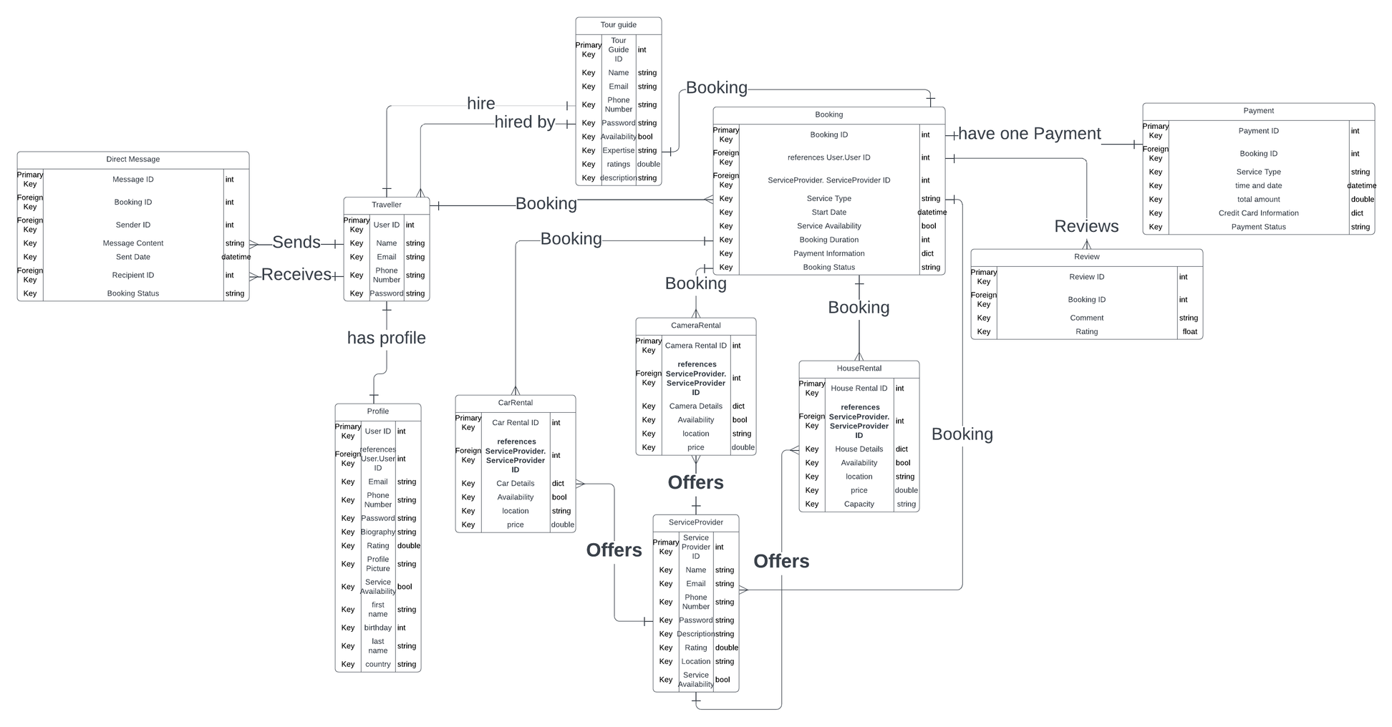
Entity Relationship Diagram ( ERD)

Slide 17
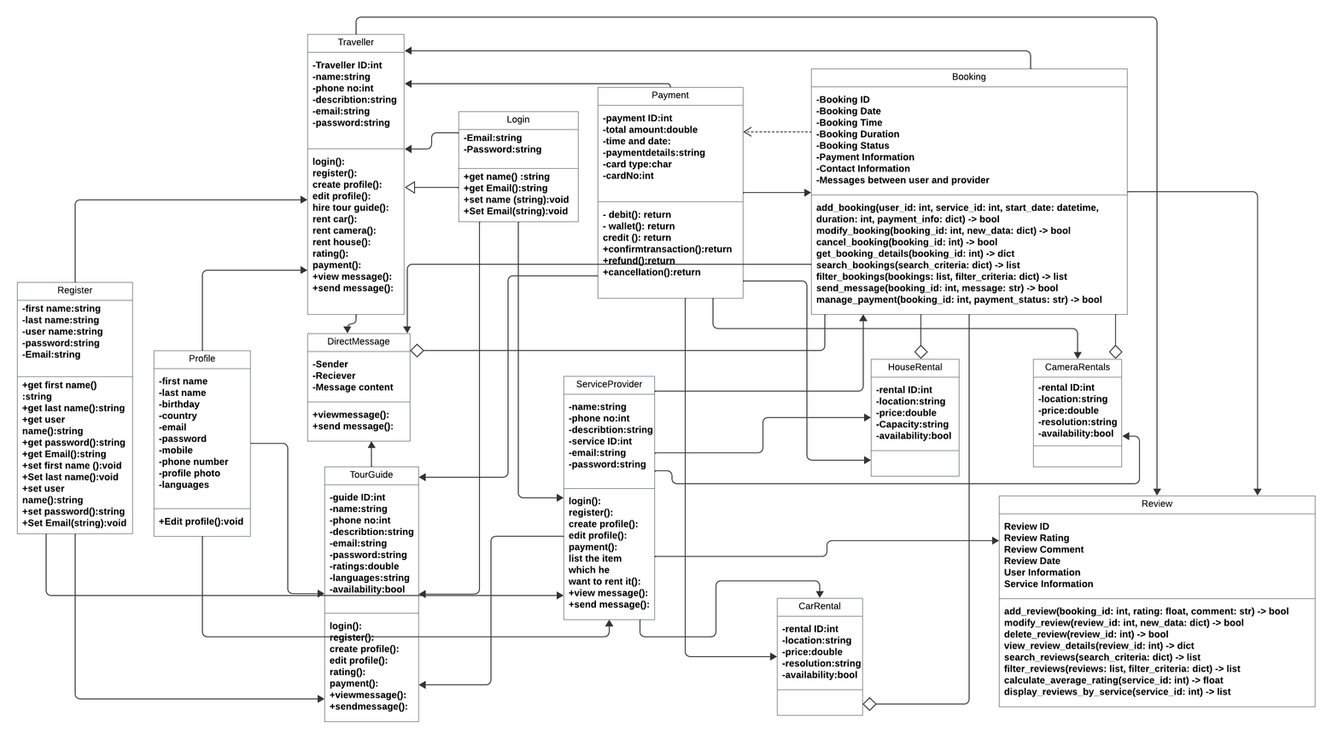
Class Diagram

Slide 18
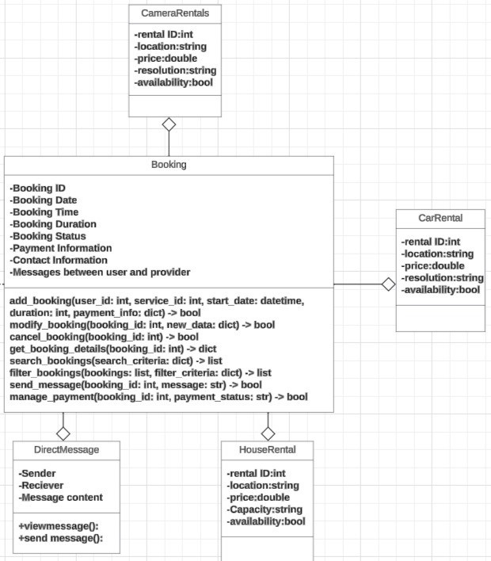
Class Diagram

Slide 19
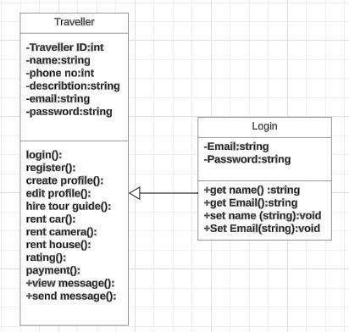
Class Diagram

Slide 20
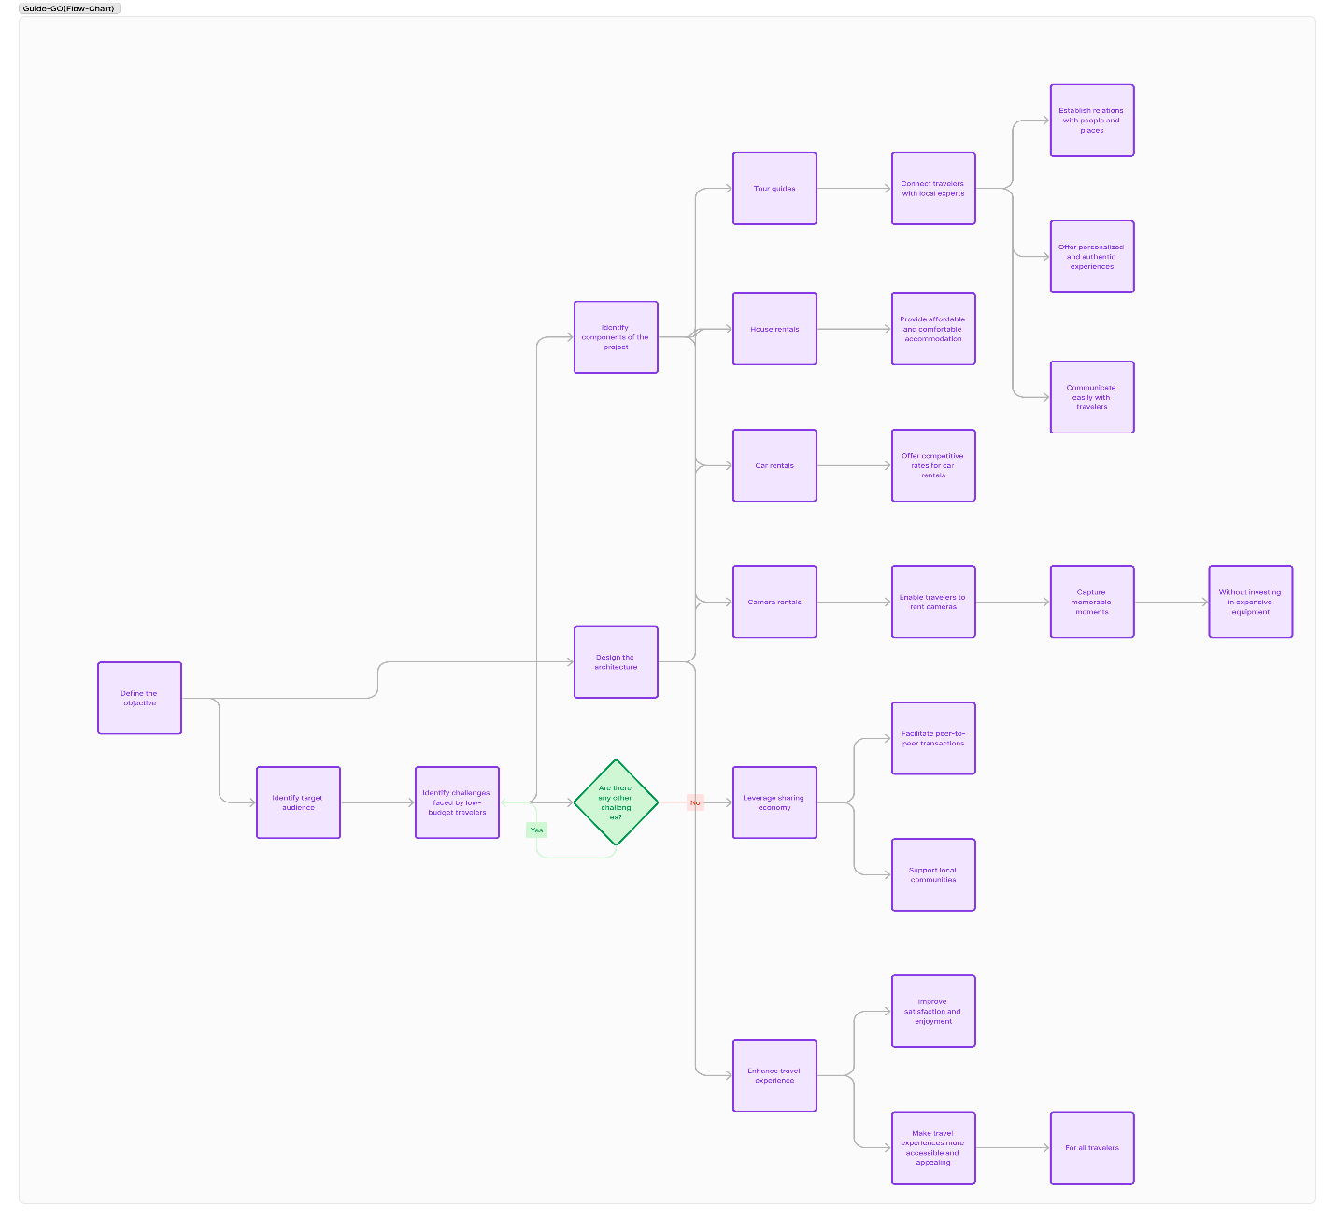
Data Flow Diagram (DFD)

Slide 21
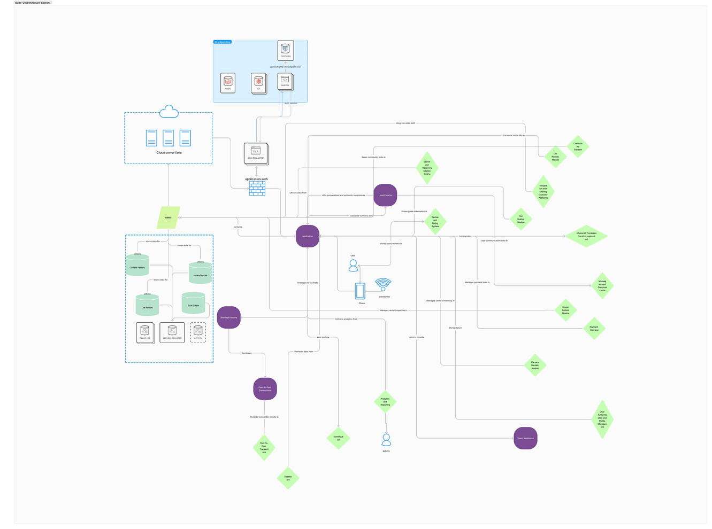
Component Diagram

Slide 22












Tools and Resources Utilized in the Project
Lucid chart
Draw io
Visual studio code
Flutter
Firebase
GitHub
Figma
Android Studio
Adobe photoshop
Gemini
chat GPT
google cloud
Lottie

Slide 23
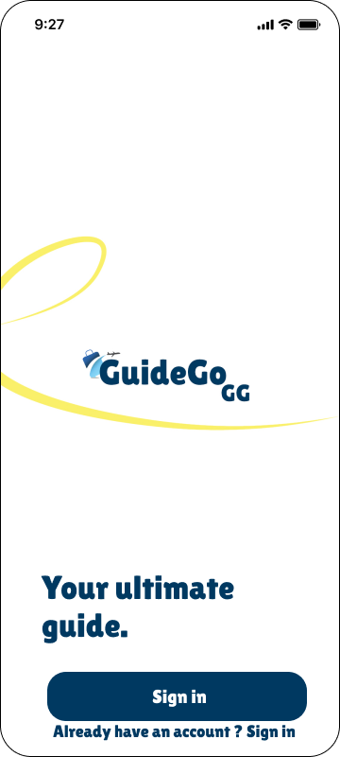
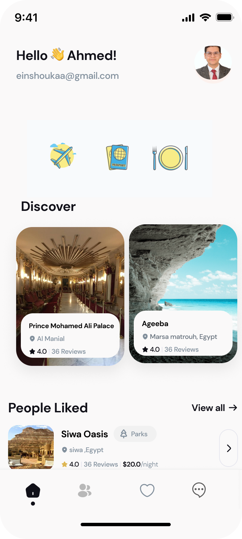
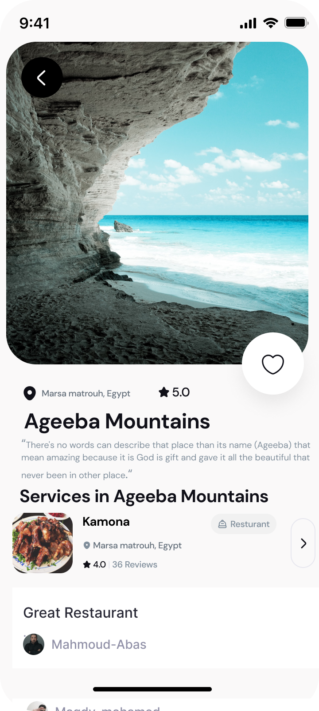
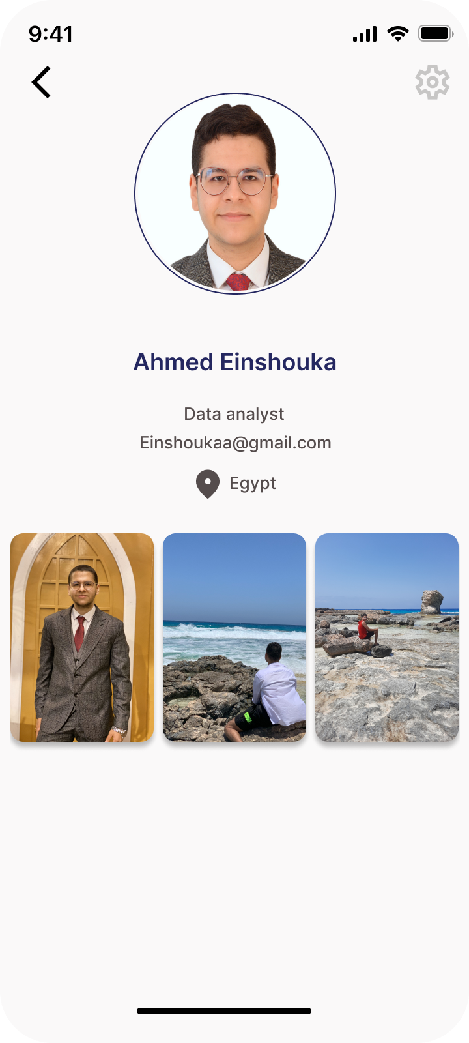
UI Design
Ui design link : https://www.figma.com/design/M3PeHSt776daSzJvAECG7u/Untitled?node-id=531-840&t=xwovAxE78qWUaztB-1

Slide 24
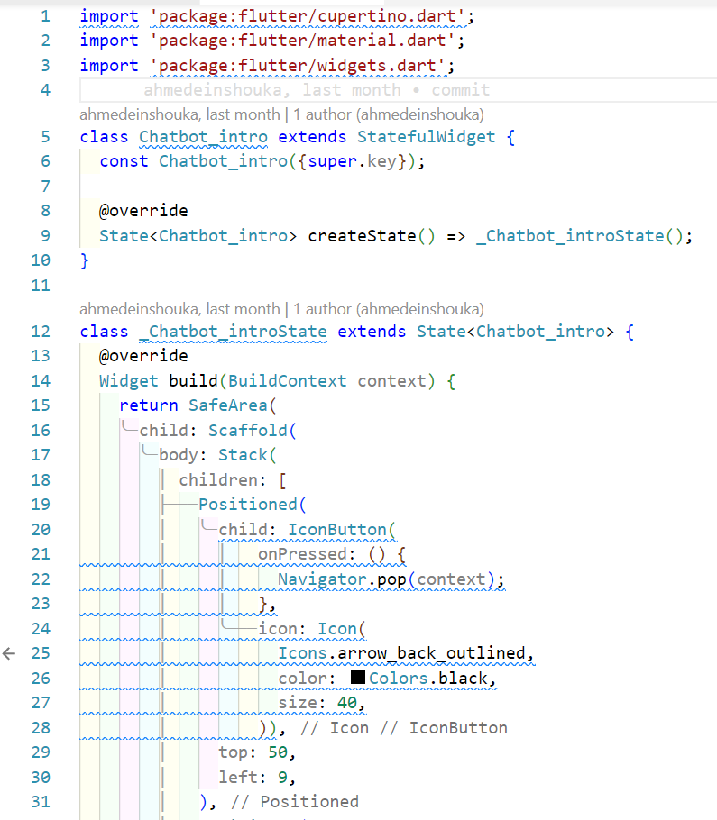
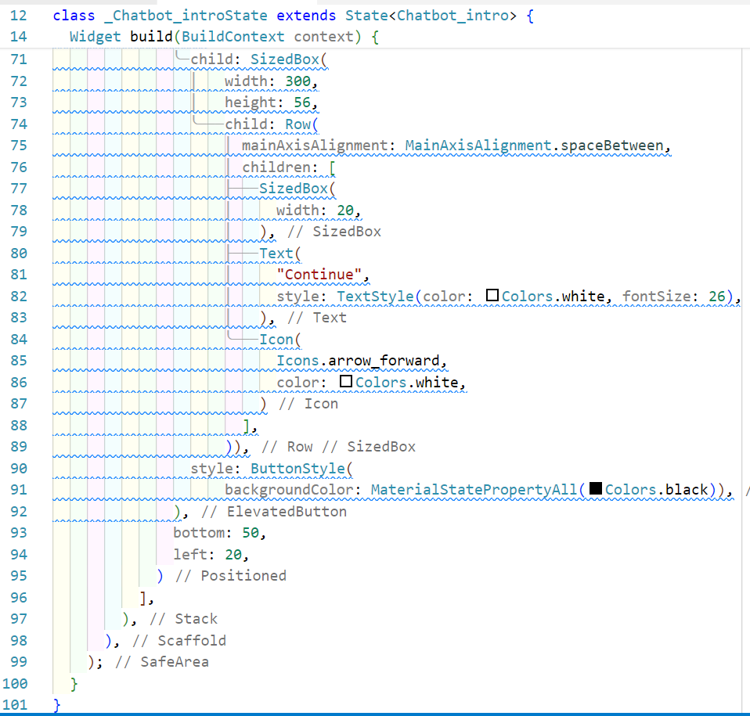
sample of source code

Slide 25
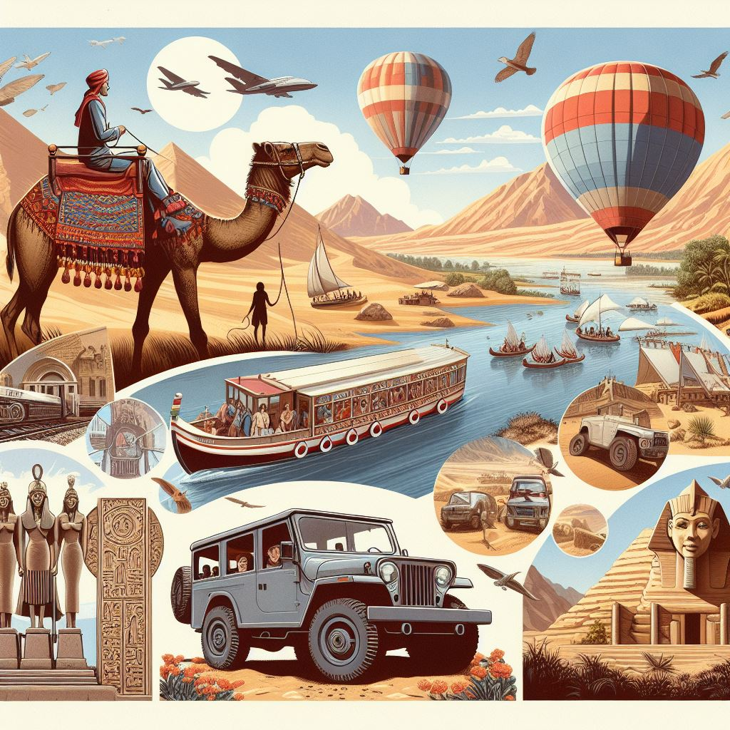

Guide GO |GG|
Your easiest way to travel

Slide 26
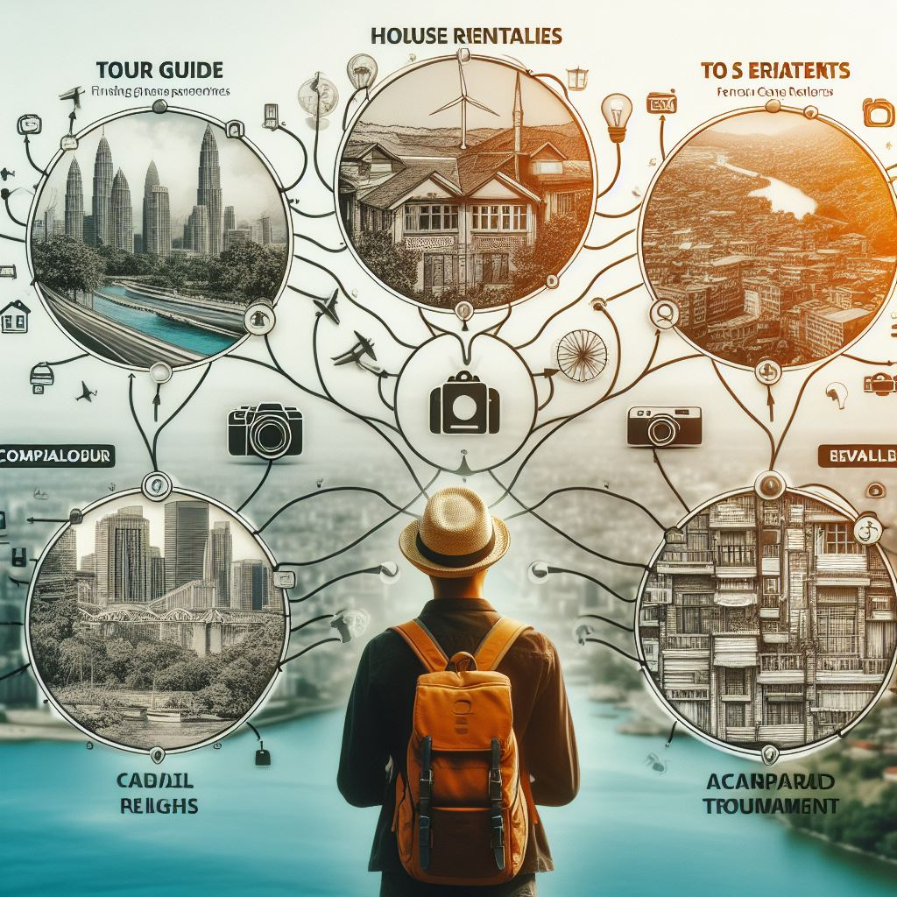
Future goals
Service Provider Profile Management
Create and edit Service Provider profiles.
Update Service Provider information.
Property listing features for house, car, and camera owners.
Booking Management
Handle booking requests for guides, houses, cars, and cameras.
Secure payment and withdrawal options.
Manage transactions and clear cancellation/refund policies.
Add a commission feature to facilitate transactions between travelers, tour guides, and service providers, ensuring a secure and transparent payment process.
Additional Features
Document scanner feature.
System notifications.
Data analytics tools.
Data backup and recovery measures.
Multi-language support interface.

Slide 27

Conclusion
Helping Low-Budget Travelers:
Guide Go offers reliable and affordable travel solutions.
Making Travel Easier:
We make travel enjoyable and accessible for everyone, regardless of budget.
Building a Travel Community:
Our platform connects travelers and service providers, supporting responsible tourism.
Changing Budget Travel:
Guide Go provides an easy-to-use platform for affordable adventures.
Filling Market Gaps:
We offer the reliable and affordable travel services people need.
Making Travel Accessible for All:
Guide Go improves travel for low-budget travelers, building a supportive community and supporting local economies. We are committed to enhancing the platform for all travelers.

Slide 28
Feel free to ask any question?

